Slide 1
Predicting Obesity Levels by Linking Personal Information and Lifestyle Factors
Data Mining, Fall 2024
Team11 313553053 康峻瑋 313554059 林滋隆 313554046 許茗鈞 413551001 黃正鵬

Slide 2
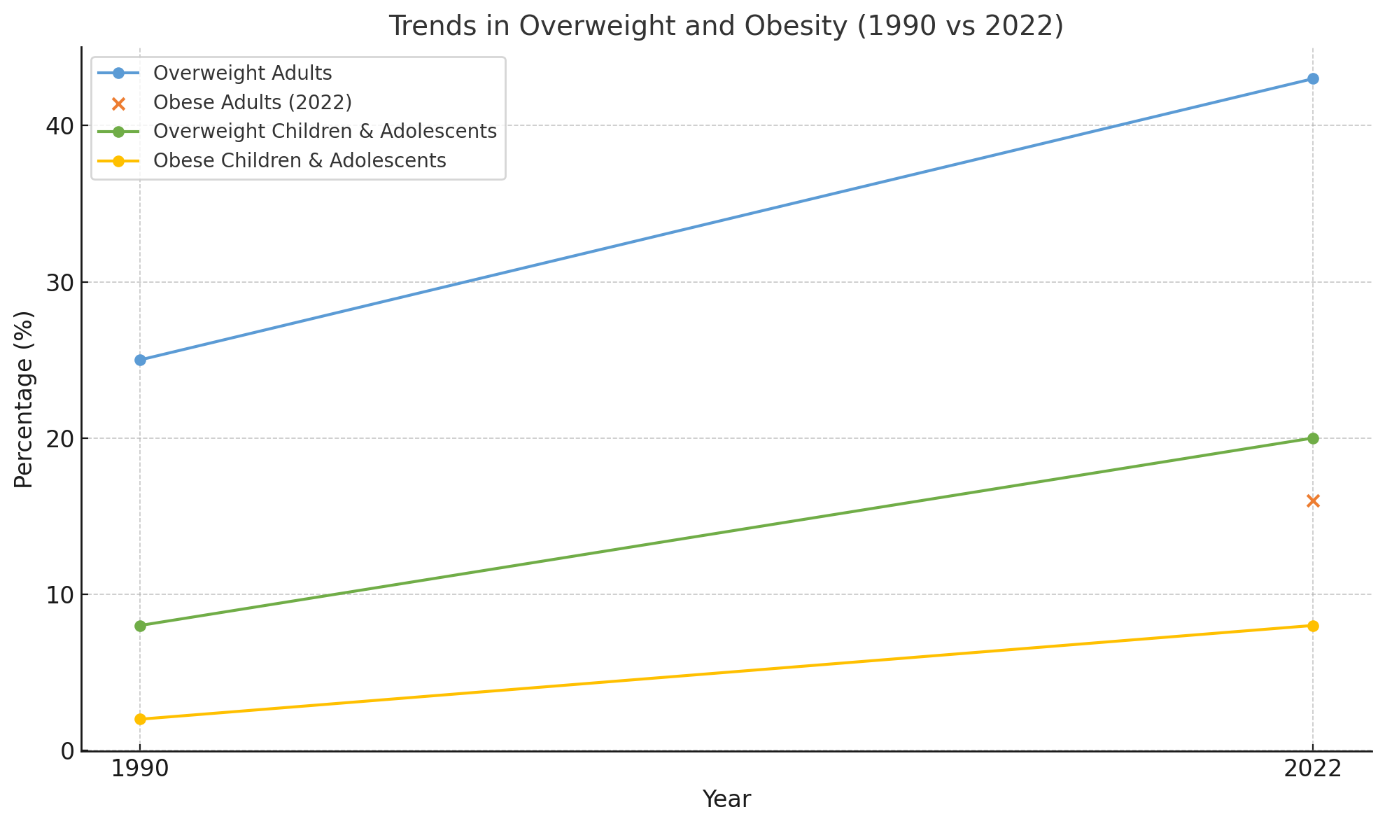
Background
Obesity is a growing global health concern,influenced by multiple factors such as genetics, personal lifestyle, and dietary habits.
Resource: https://www.who.int/news-room/fact-sheets/detail/obesity-and-overweight

Slide 3
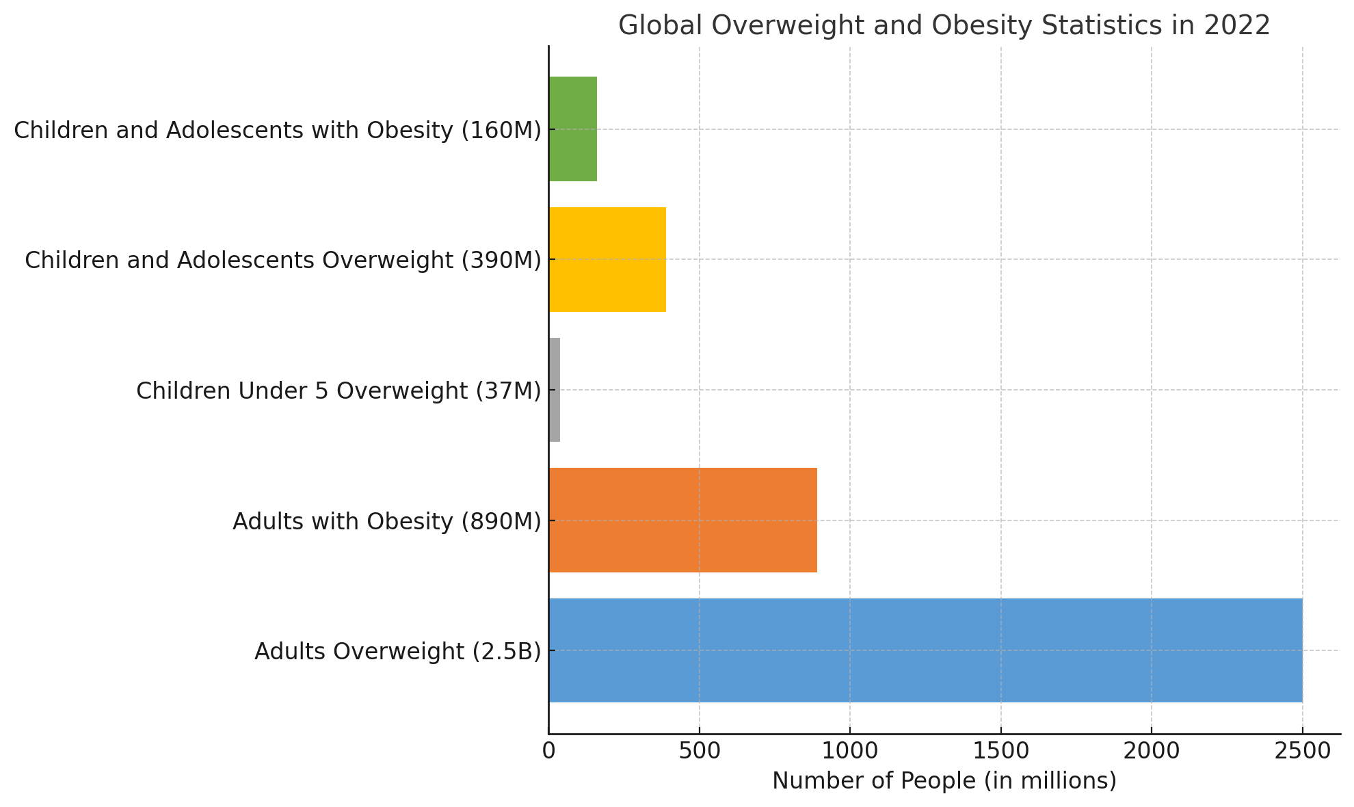
Background
Obesity is a growing global health concern,influenced by multiple factors such as genetics, personal lifestyle, and dietary habits.
Resource: https://www.who.int/news-room/fact-sheets/detail/obesity-and-overweight
Notes:
過重與肥胖人口比例與日俱增

Slide 4
Motivation and Research Aims
The study is motivated by the rising obesity rates and the potential of machine learning tools to enhance predictive accuracy.
Data mining techniques allow us to analyze complex patterns in personal and lifestyle data to predict obesity risk, enabling early interventions and promoting healthier living habits.
By linking factors such as age, physical activity, and eating habits, predictive models can provide insights into how these variables contribute to obesity.
Overweight and obesity result from an imbalance of energy intake (diet) and energy expenditure (physical activity).
early interventions and promoting healthier living habits
detecting causes of obesity.
The aim of this research is to use data mining techniques to predict obesity levels based on a combination of personal and lifestyle factors.
Using predictive models to identify high-risk individuals and provide actionable insights for health promotion.
Notes:
兩大變因導致肥胖：飲食、勞動(運動)
目標 1.預測肥胖程度 2.找到肥胖原因

Slide 5
Problem Description
- **Obesity Level Prediction**: Use classification models to predict obesity levels based on features like age, eating habits, and physical activity. You could explore binary classification (obese vs. non-obese) or multi-class classification (e.g., different levels of obesity).
- **Linking Lifestyle Factors to Obesity Levels**: Predict the likelihood that certain lifestyle factors (e.g., high fast food consumption, low physical activity) lead to obesity. You could model this as predicting the "links" between lifestyle choices and obesity levels.
Predicting Obesity Levels by Linking Personal and Lifestyle Factors
Input: Dataset includes 16 columns of personal (age, height, weight…etc) and lifestyle (number of daily meals, smoking status…etc) factors.
Process:
Obesity Level Prediction
Use classification models (i.e. Decision Trees, Random Forest, Gradient Boosting) to predict obesity levels
Linking Lifestyle Factors to Obesity Levels
Predict the likelihood (i.e. Logistic Regression, Collaborative Filtering) that certain lifestyle factors (i.e. high fast food consumption, low physical activity) lead to obesity
Output:
Prediction: weight Level (4 levels), Obesity Type (3 types)
Linking: "links" between lifestyle choices and obesity levels
Feature selection and classification models (like Decision Trees, Random Forest) are used to train predictions and analyze the link between lifestyle and obesity.
Notes:
輸入 16個欄位，分為：個人資訊、生活習慣 兩類
輸出 1.肥胖分類 2.導致肥胖的原因

Slide 6
Target Performance
Authors | Research Objective | Results
(Thamrin, Arsyad, et al., 2021) | Predicting obesity in adults | Accuracy: 72%, AUC: 79%
(Cheng et al., 2021) | Prediction of the effect of physical activity on obesity | Accuracy: 67% AUC: 64%
(Santisteban Quiroz, 2022) | Identifying obesity levels based on lifestyle through ML techniques | Accuracy: 97.45% AUC: 99.90%
https://www.ncbi.nlm.nih.gov/pmc/articles/PMC8176949/table/T1
https://www.researchgate.net/publication/376813634_Machine_Learning_Approach_of_Obesity_Level_Classification_A_Systematic_Literature_Review_of_Methods_and_Factors
Target
Accuracy 90% up
AUC 80% up
Machine Learning Approach of Obesity Level Classification: A Systematic Literature Review of Methods and Factors p201-p203
Notes:
參考三篇相關主題論文訂出目標值
不與類神經網路、深度學習等技術比較

Slide 7
Data Description
Download resource: kaggle
https://www.kaggle.com/datasets/jayitabhattacharyya/estimation-of-obesity-levels-uci-dataset/
Original resource: UC Irvine Machine Learning Repository(Donated on 8/26/2019)
https://archive.ics.uci.edu/dataset/544/estimation+of+obesity+levels+based+on+eating+habits+and+physical+condition
Features: 16 + 1 class variable
Instances: 2111 records
Data acquired by: survey
Dataset brief https://www.sciencedirect.com/science/article/pii/S2352340919306985?via%3Dihub
Notes:
Kaggle 公開資料源，原始資料為問卷調查
16個屬性欄位，1個目標欄位
2111筆紀錄

Slide 8
Data Description (cont.)
Variable Name | Role | Type | Description | Missing Values
Gender | Feature | Categorical |  | no
Age | Feature | Continuous |  | no
Height | Feature | Continuous |  | no
Weight | Feature | Continuous |  | no
family_history_with_overweight | Feature | Binary | Has a family member suffered or suffers from overweight? | no
FAVC | Feature | Binary | Do you eat high caloric food frequently? | no
FCVC | Feature | Integer | Do you usually eat vegetables in your meals? | no
NCP | Feature | Continuous | How many main meals do you have daily? | no
CAEC | Feature | Categorical | Do you eat any food between meals? | no
SMOKE | Feature | Binary | Do you smoke? | no
https://archive.ics.uci.edu/dataset/544/estimation+of+obesity+levels+based+on+eating+habits+and+physical+condition
Notes:
資料類型：布林、類別、整數、數值

Slide 9
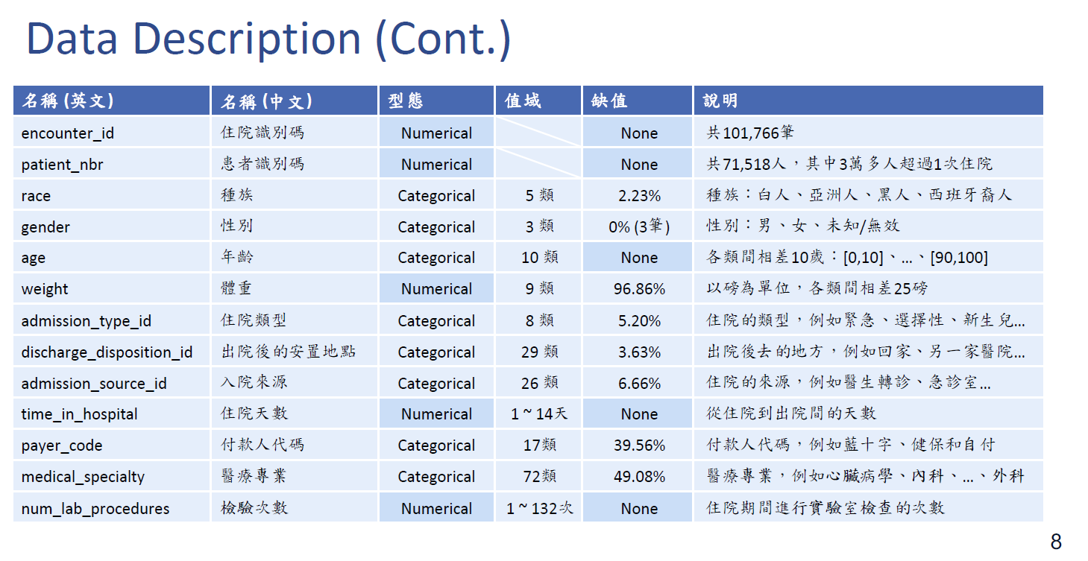
Data Description (cont.)
Atributes profiling https://www.kaggle.com/code/mpwolke/obesity-levels-life-style/notebook
Variable Name | Role | Type | Description | Missing Values
CH2O | Feature | Continuous | How much water do you drink daily? | no
SCC | Feature | Binary | Do you monitor the calories you eat daily? | no
FAF | Feature | Continuous | How often do you have physical activity? | no
TUE | Feature | Integer | How much time do you use technological devices such as cell phone, videogames, television, computer and others? | no
CALC | Feature | Categorical | How often do you drink alcohol? | no
MTRANS | Feature | Categorical | Which transportation do you usually use? | no
NObeyesdad | Target | Categorical | Obesity level | no

Slide 10
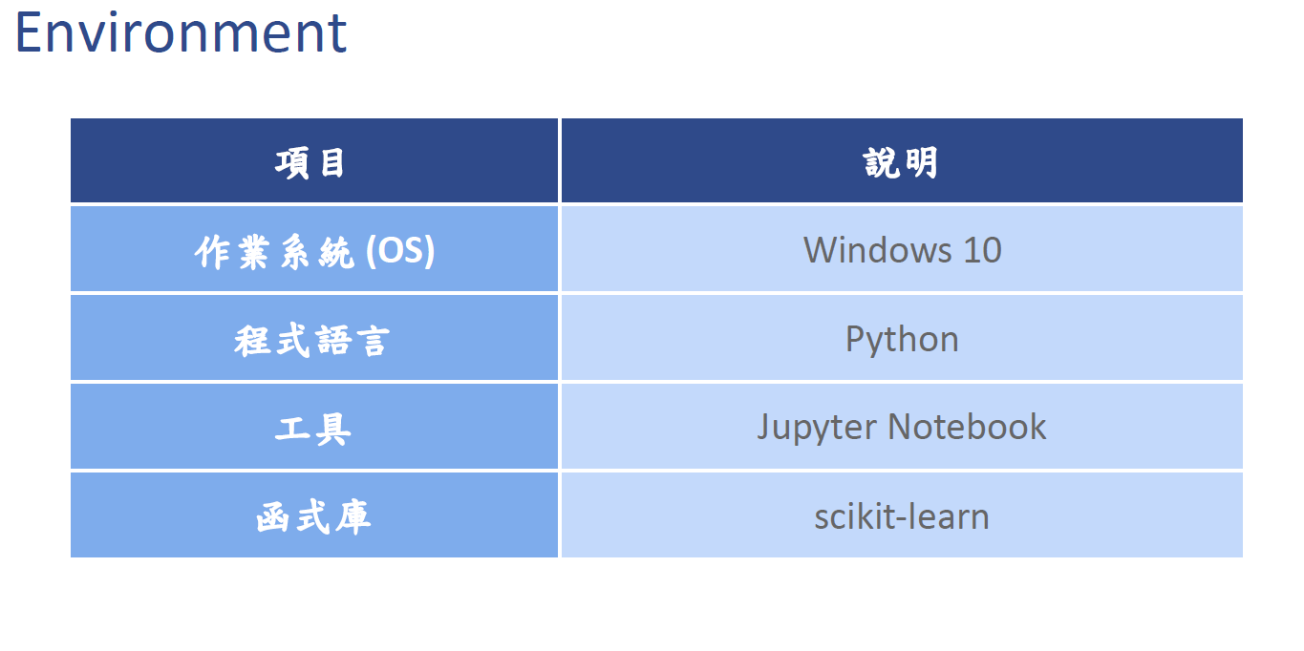
Environment
macOS 14+
Python
Jupyter Notebook
Scikit-learn

Slide 11
Analysis Workflow
Suggested Workflow:
Data Preprocessing: Clean your data, handle missing values, and perform feature scaling (especially for algorithms like SVM and k-NN).
Model Selection: Start with simpler models (e.g., logistic regression, decision trees) and gradually move to more complex ones (e.g., Random Forest, XGBoost).
Evaluation: Use cross-validation to assess model performance. Consider metrics like accuracy, F1-score, precision, recall for classification, and AUC-ROC for link prediction.
https://vinta.ws/code/feature-engineering.html
Data Processing: Check for unusual data, inconsistent data, outliers or missing values
Data Transformation: Convert to numerical representation (label encoding or one-hot encoding), Scale using normalization or standardization
Feature Engineering: Binning (bucketization),Feature Combination, Feature Selection (i.e. exclude Height and Weight)
Modeling:
Classification: Decision Trees, Random Forest, Gradient Boosting (e.g., XGBoost, LightGBM, CatBoost), Support Vector Machines (SVM), k-Nearest Neighbors (k-NN)
Link analysis: Logistic Regression, Collaborative Filtering, Matrix Factorization
Evaluation: Use cross-validation to assess model performance.
Classification: accuracy, F1-score, precision, recall
Link prediction: AUC
Notes:
針對不同欄位資料型態進行檢查、轉換、特徵選取(BMI來自身高體重)
參考相關研究
1.挑選3-5個常見演算法與模型進行實驗
2.挑選常見評估值進行驗證與比較

Slide 12
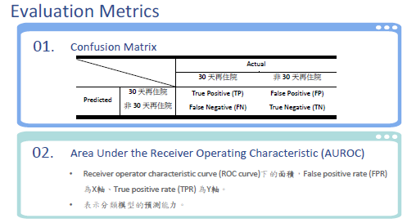
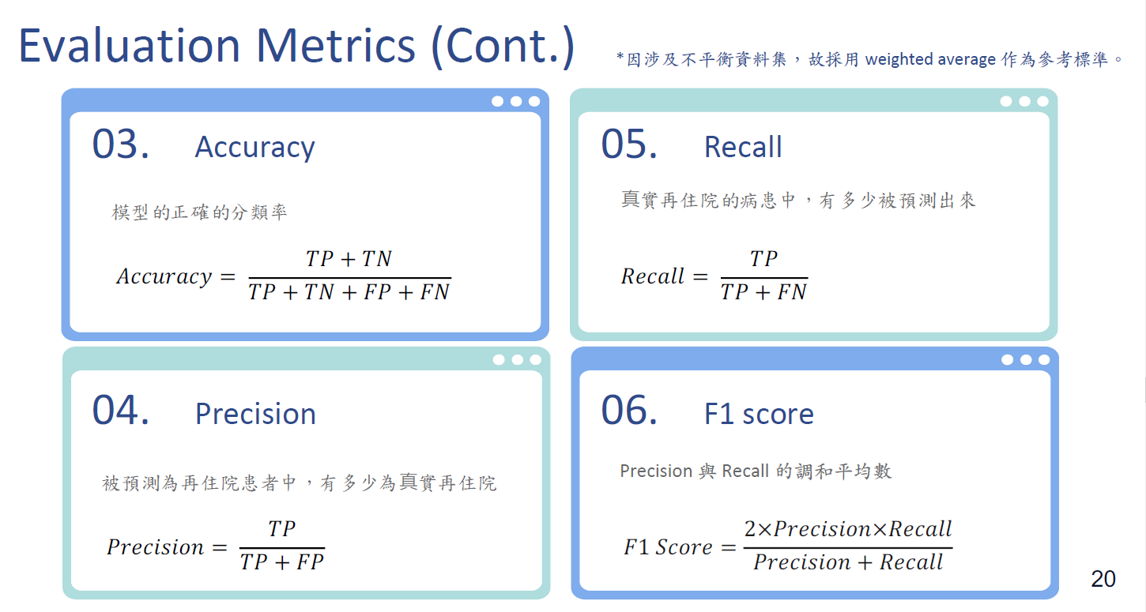
Evaluation
Confusion Matrix Helps identify how well the model predicts different obesity types or weight levels and highlights common errors.
AUROC Measures the model's ability to classify obesity types or weight levels across all classes.
Accuracy The percentage of correct predictions for obesity types or weight levels, though it can be misleading with class imbalances.
Precision Of those predicted to be a certain obesity type, how many are actually correct.
Recall Of those who truly belong to a certain obesity type, how many are correctly identified.
F1 Score Balances precision and recall to evaluate overall prediction performance.
Notes:
1. Confusion Matrix
在肥胖分類中，混淆矩陣可以幫助理解模型在不同體重等級或肥胖類型上的預測是否準確，並看出常出現的錯誤類型
2. AUROC
在多類別分類問題中，AUROC 可以擴展為每個類別的曲線，衡量模型在不同肥胖類型或體重等級上的分類能力。
3. accuracy
模型預測正確的體重等級或肥胖類型的比例。但在類別不平衡的情況下（某些類別樣本數遠多於其他類別），準確率可能會導致偏差。
4.precision
被預測為某肥胖類型的人中，有多少人實際屬於該類別。
5.recall
真實屬於某一肥胖類型的人中，有多少被模型正確預測出來。
6.F1 score
F1 分數能夠綜合評估模型在正確預測肥胖類型或體重等級時的表現

Slide 13
Tentative Schedule
.
Week 1 (10/04 - 10/11): Proposal topic discussion and determination
Proposal topic discussion and determination Finalize the research topic
plan the steps for data preprocessing, feature engineering, and model training for obesity prediction.
Week 2 (10/12 - 10/18): Data preprocessing
Clean and preprocess the data, handling missing and outlier values.
Week 3 (10/19 - 10/25):Feature Engineering (EDA) // 1 week
Perform EDA to identify the most influential features for obesity prediction.
Week 4-8 (10/26 - 11/23): Modelling & Evaluation
Train classification models like decision trees and random forests.
Explore link analysis to predict the association between lifestyle factors and obesity.
Test the models, evaluate accuracy, precision, and recall, and optimize accordingly.
Week 9 (11/24 - 12/1): Final report and presentation preparation
Summarize findings and write the final report.
Prepare the presentation for the final demonstration.
Notes:
Week 1 (10/04 - 10/11): Proposal topic discussion and determination
提案主題討論及確定研究主題並規劃肥胖預測的資料預處理、特徵工程和模型訓練的步驟。
Week 2 (10/12 - 10/18): Data preprocessing
Clean and preprocess the data, handling missing and outlier values.
Week 3 (10/19 - 10/25): Feature selection and exploratory data analysis (EDA)
執行 EDA 以確定對肥胖預測最有影響力的特徵。
Week 4-8 (10/26 - 11/23): Modelling & Evaluation
訓練決策樹和隨機森林等分類模型。
探討連結分析以預測生活方式因素與肥胖之間的關聯。
測試模型，評估準確度、精確度和召回率，並進行相應最佳化。
Week 9 (11/24 - 12/1): Final report and presentation preparation
總結調查結果並撰寫最終報告。
準備最終簡報的簡報。

Slide 14
Thank You
Data Mining, Fall 2024
Team11 313553053 康峻瑋 313554059 林滋隆 313554046 許茗鈞 413551001 黃正鵬

Slide 15
QA
Data Mining, Fall 2024
Team11 313553053 康峻瑋 313554059 林滋隆 313554046 許茗鈞 413551001 黃正鵬

